Slide 1
Telesciences/ Geoscience:
Shinji Shimojo, Fang-Pang Lin, Sornthep Vannarat
Pragma 27

Slide 2
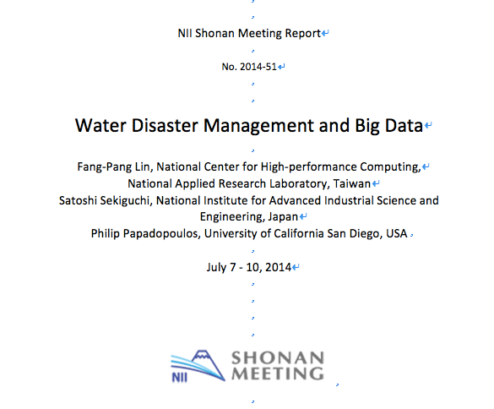

Slide 3
Notes:
typhoon, land slide, earth quake, tornade, flooding

Slide 4
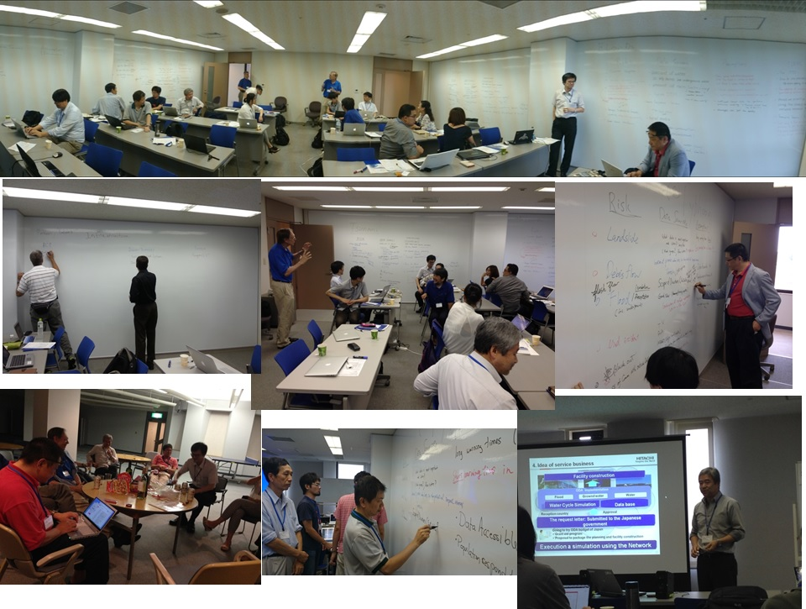

Slide 5
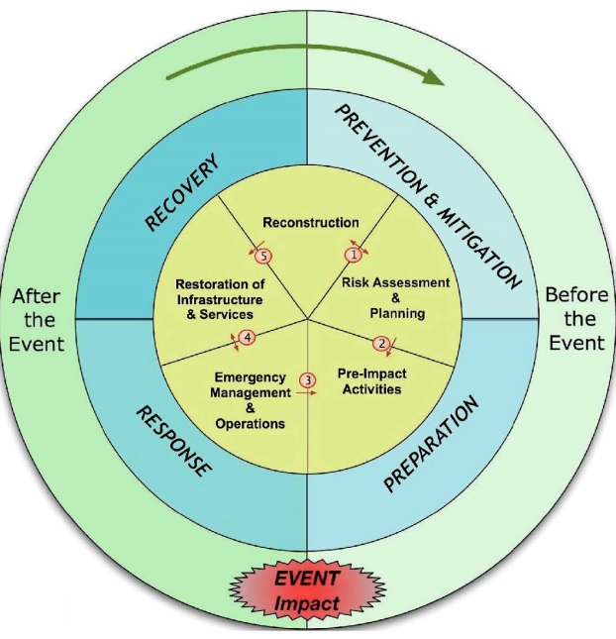
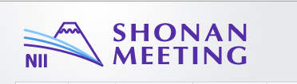
Water Disaster Management and Big Data Phases in Disaster Management
Quick or Slow onset
Monitoring, predicting, communicating and responding
From Earthzine (http://www.earthzine.org/disaster-management-theme/). Vanneuville et all, posted March 21, 2011

Slide 6
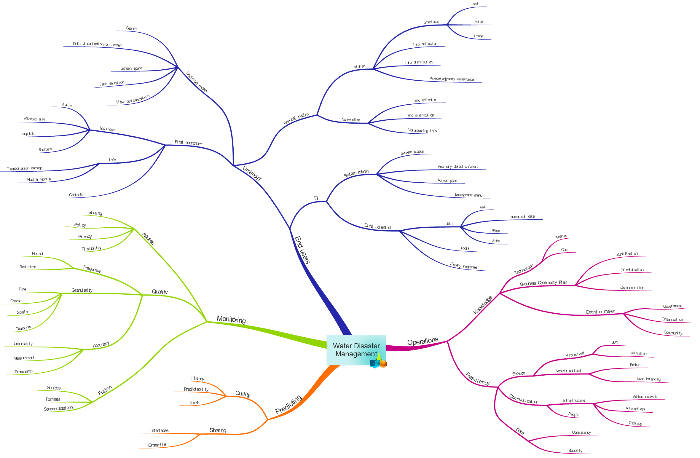
Understand the Real Problems of Disaster Managment
Made by Prapaporn Rattanatamrong, Jason Haga and Kyong-Sook Kim

Slide 7


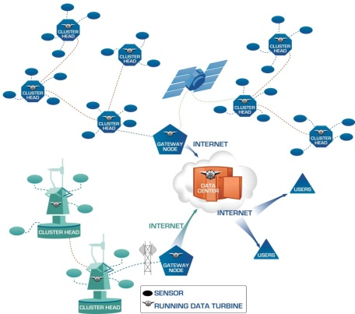
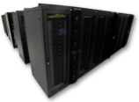
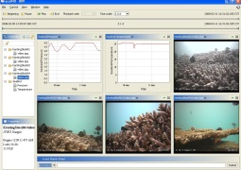

Future Collaboration in Big Data service: Service Continuity through Virtual Data Centers
Sensor Networks:
Data Sources
Virtual Data Center
Virtual Data Center (backup services)
Data Flow
by Phil Papadopoulos

Slide 8
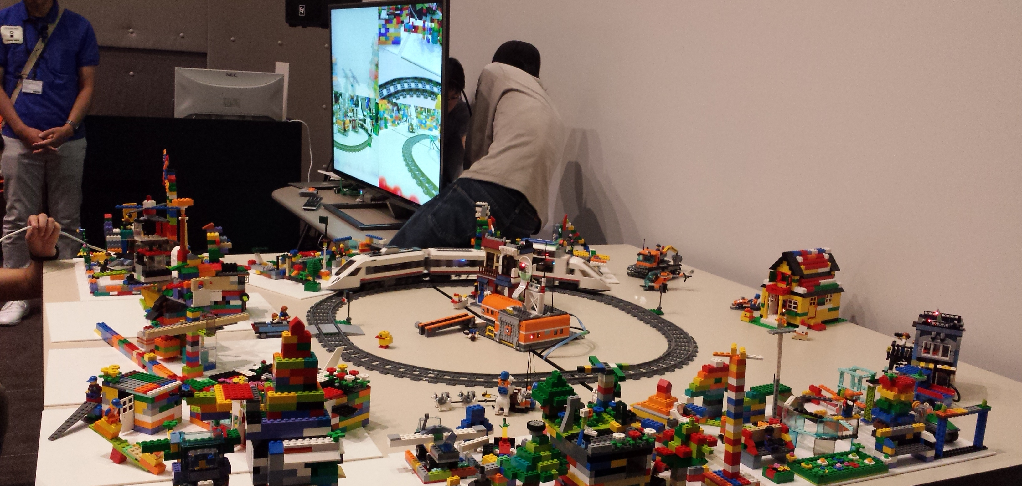
Collaboration with Kobe Institute and the Lab
Interactive model for the railroad museum Nicole Wong

Slide 9
day 1
Nor Arlina Amirah Ahmad Ghani, Nurul Shakina Mohd Talkah, Shaiful Rahim, Iylia Zulkifli, Parveendeerjeet Kaur Bal, Mohd Shahir Shamsir Omar, “Implementing Citizen Science in Biodiversity Conservation: A Case Study of EcoSabah Android Application Reporting Solution for Species Occurrences in Sabah, Malaysia”
Dr. Jongsung Lee, “disaster monitoring and mitigation.”
Report from disaster mitigation, Fang Pang and me.
Dr. Wen-Yii Chang "A River Basin-based Real-time Bridge Safety Warning System"

Slide 10
day 2
Discussion on disaster mitigation on Pragma ENT

